Slide 1




How to Create and Play
Your Sims Anywhere
Judy Smith & Jonathan Kaye

Slide 2
Why ‘Anywhere’?
Often need to show sims in different place from where you created them
Can give out sims for others to use for free

Slide 3
‘Anywhere’ Options
Windows/Mac:
  Free SimsUshare Viewer on desktop, laptop, network, USB drive
Mobile (Android or iOS):
  Requires SimsUshare Mobile (US $9.99)

Slide 4
Basic Steps, Part I
Download SimsUshare Sim Viewer installer
Install program onto computer
Copy
  SimsUshare_v2 program folder from C:\ProgramFiles (x86) to USB Drive
    Optional: rename this folder on USB drive
  Your simulations onto USB drive (from Documents\SimsUshare)
    Optional: rename this folder on USB drive

Slide 5
Basic Steps, Part II
On computer for viewing, insert USB drive
Run the SimsUshare application from folder in USB drive
Main menu: “Change Main Sim Folder” point to folder of the sims you copied onto your USB drive
In SimsUshare, click on PLAY to see your sims.

Slide 6
Synopsis
Download SimsUshare installer
Install program onto computer
Copy
  SimsUshare_v2 program folder from C:\ProgramFiles (x86) to USB Drive
    Optional: rename this folder on USB drive
  Your simulations onto USB drive (Documents\SimsUshare)
    Optional: rename this folder on USB drive
On computer for viewing:
  Run the SimsUshare application from folder in USB drive
  Main menu: “Change Main Sim Folder” to USB sim folder.

Slide 7
Additional Notes
Create or Edit Sims: If you want to create or edit on the computer, enter the license code (remember to deactivate on original computer, if you don’t have an additional license).
Install on Network
  Same process, but put in shared folder instead of USB drive
  We strongly suggest you use SimsUshare Network because you can setup a configuration file to skip having to set the simulation folder for each user.

Slide 8
Distributing your Simulations
Simulations are in Documents\SimsUshare folder
Easier to copy whole SimsUshare folder, but you can copy individual sims, be sure to copy into the same place on your USB drive
Folder names can be whatever you want
Important: when choosing Main Sim Folder inside SimsUshare, point to top-level SimsUshare folder, not “sims” sub-folder.

Slide 9
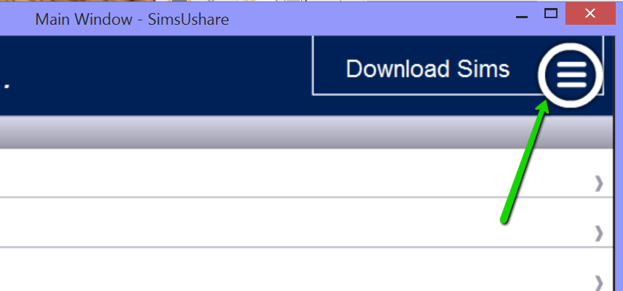
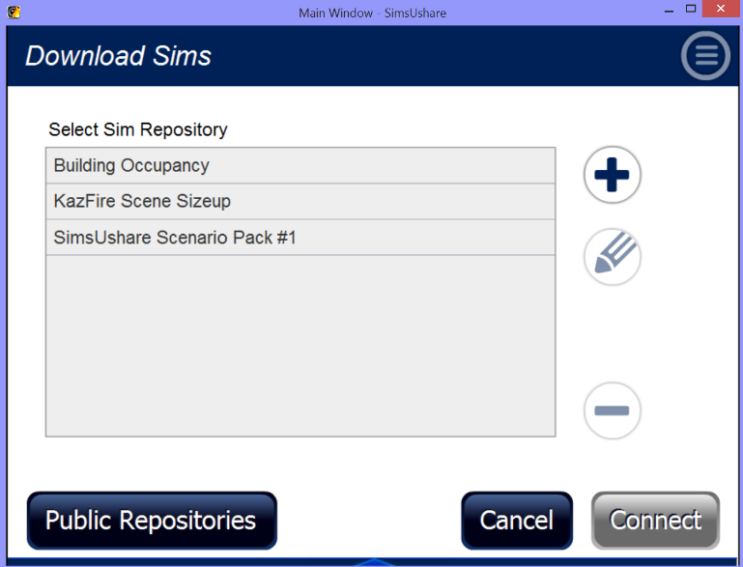
Sim Repositories
If you have a web server, you can package your sims in a “sim repository” to allow downloading into program on any platform (mobile included)
Help page on SimsUshare.com has video tutorials

Slide 10
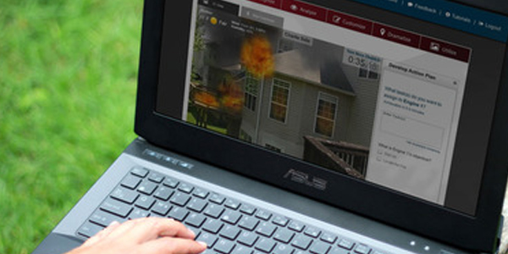
Upcoming: AlphaACT FIRE
What is AlphaACT FIRE?
  AlphaACT FIRE teaches you
  how to leverage experiences
  from the past to make better
  decisions today
  Can use SimsUshare to create
  visuals/simulations
Webinar: September 28, 2016 at 11:30AM Eastern
  Signup on our Events area:
  http://simsushare.com/about-us/

Slide 11

Wrap-Up: Your Questions
Next User Group Webinar:
January 18, 2016 @ 11:30am EST
Sales
  Judy Smith, judy@globalriskinnovations.com
  Tel: (866) 639-8727
Tech Support
  Jonathan Kaye, jonathan@simsushare.com

